Slide 1
Exposure Activity 5
Data Analysis Using Google Sheets
Rohit Jaiswal (3233205)

Slide 2
Functions and Features being used for the analysis are :
Pivot Table
Charts
VLOOKUP functions
IF functions & Variations
Other function (Week Num, sum, etc.)

Slide 3
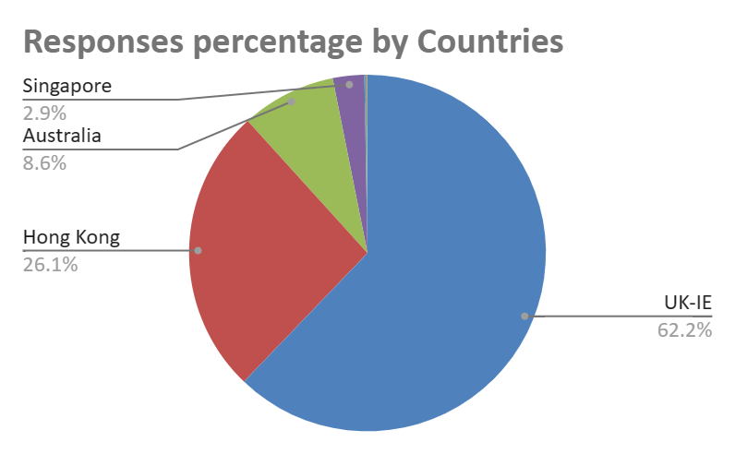
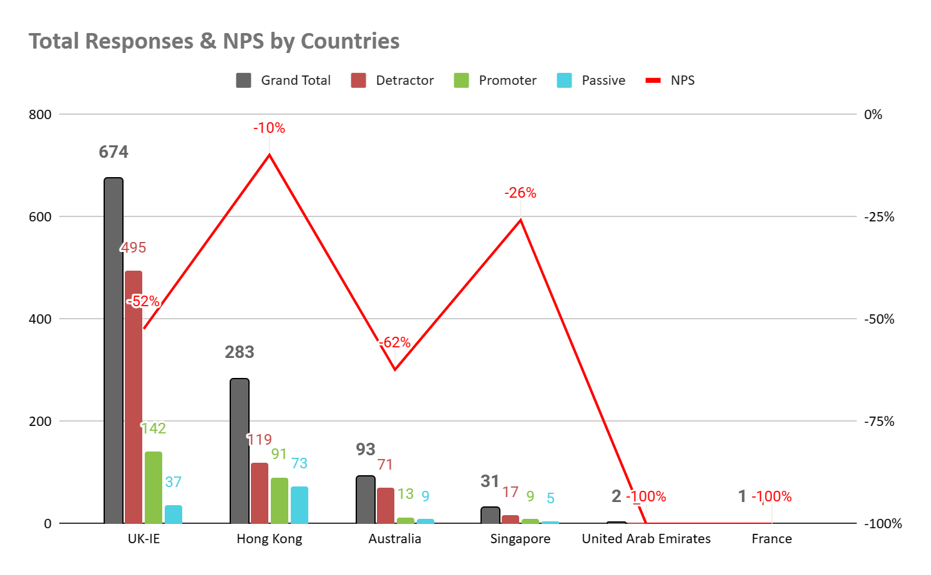
COUNT of promoter_detractor
Country Name | Detractor | Passive | Promoter | Grand Total | NPS
UK-IE | 495 | 37 | 142 | 674 | -52%
Hong Kong | 119 | 73 | 91 | 283 | -10%
Australia | 71 | 9 | 13 | 93 | -62%
Singapore | 17 | 5 | 9 | 31 | -26%
United Arab Emirates | 2 |  |  | 2 | -100%
France | 1 |  |  | 1 | -100%
Grand Total | 705 | 124 | 255 | 1084 | -42%
It has been observed in the following chart and table that the highest contribution in responses has been from UK followed by Hong Kong, Australia, Singapore, UAE and then France.
The NPS of the countries can also be seen where UAE & France have -100% NPS because of their low calls.
With substantial number of calls Australia has the lowest NPS of -62% followed by UK with -52%, Singapore with -26% & Hong Kong having highest NPS of -10%.

Slide 4
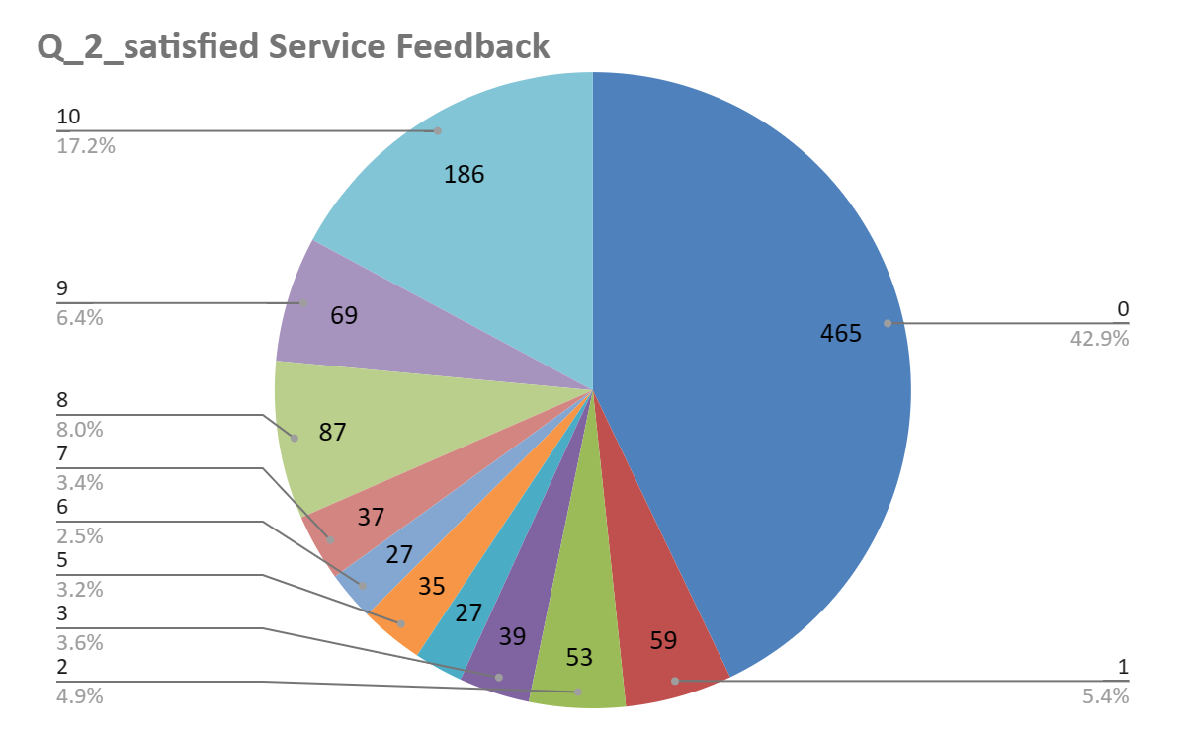
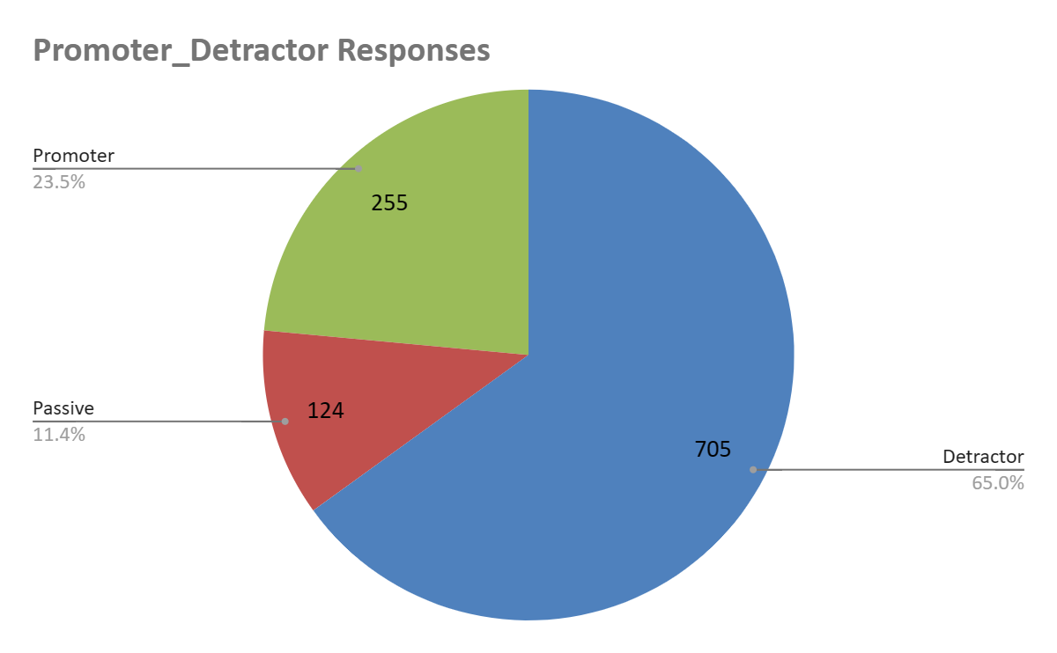
q_2_satisfied Service Feedback | Response Type | Promoter Detractor Responses
0 | Detractor | 465
1 | Detractor | 59
2 | Detractor | 53
3 | Detractor | 39
4 | Detractor | 27
5 | Detractor | 35
6 | Detractor | 27
7 | Passive | 37
8 | Passive | 87
9 | Promoter | 69
10 | Promoter | 186
Total |  | 1084
Q2 Satisfied service response showing 0 point with maximum number of responses of 465 .
Detractor having 705 responses with 65% of total responses.
Passive being at 124 responses with 11.4%.
And promoter having 255 responses with 23.5 % of responses.

Slide 5
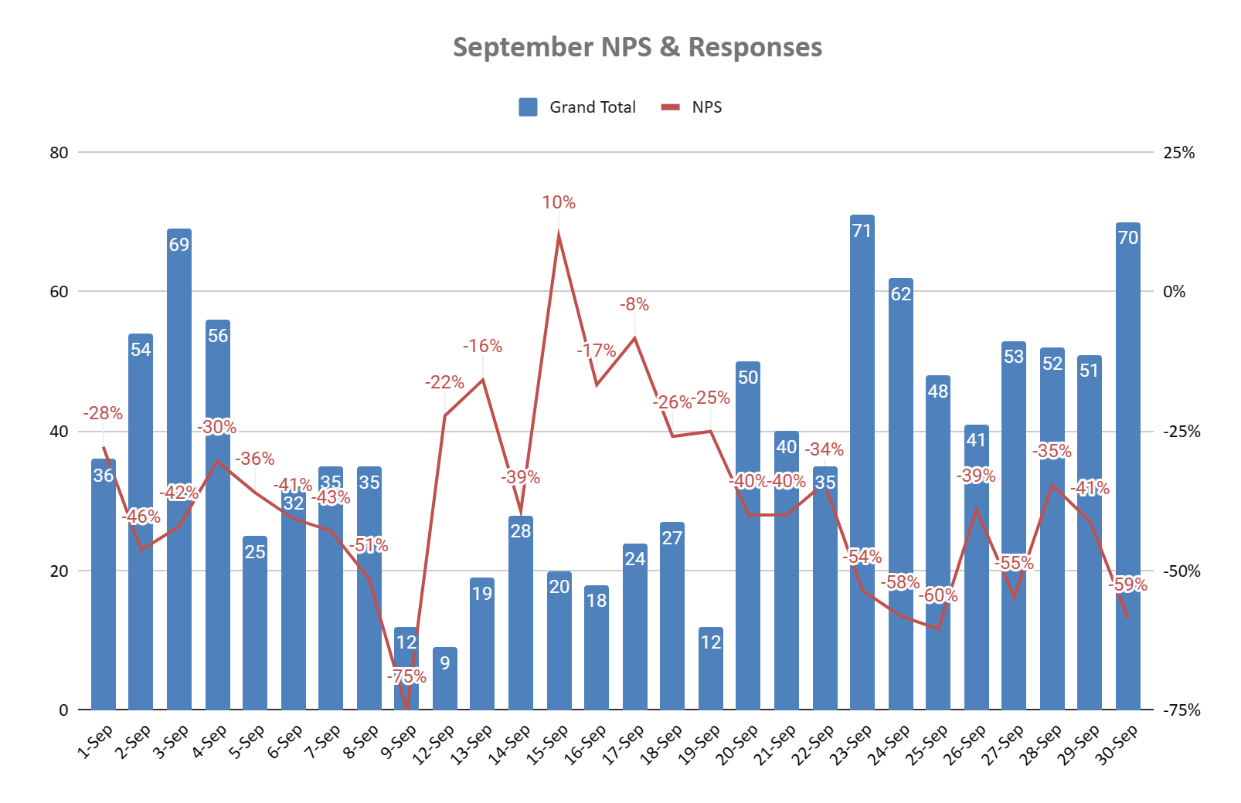
September NPS & Responses
Interaction_started_at - Day-Month |  | Detractor | Passive | Promoter | Grand Total | NPS
1-Sep |  | 21 | 4 | 11 | 36 | -28%
2-Sep |  | 37 | 5 | 12 | 54 | -46%
3-Sep |  | 45 | 8 | 16 | 69 | -42%
4-Sep |  | 32 | 9 | 15 | 56 | -30%
5-Sep |  | 15 | 4 | 6 | 25 | -36%
6-Sep |  | 20 | 5 | 7 | 32 | -41%
7-Sep |  | 22 | 6 | 7 | 35 | -43%
8-Sep |  | 24 | 5 | 6 | 35 | -51%
9-Sep |  | 10 | 1 | 1 | 12 | -75%
12-Sep |  | 5 | 1 | 3 | 9 | -22%
13-Sep |  | 9 | 4 | 6 | 19 | -16%
14-Sep |  | 17 | 5 | 6 | 28 | -39%
15-Sep |  | 6 | 6 | 8 | 20 | 10%
16-Sep |  | 9 | 3 | 6 | 18 | -17%
17-Sep |  | 10 | 6 | 8 | 24 | -8%
18-Sep |  | 14 | 6 | 7 | 27 | -26%
19-Sep |  | 5 | 5 | 2 | 12 | -25%
20-Sep |  | 33 | 4 | 13 | 50 | -40%
21-Sep |  | 25 | 6 | 9 | 40 | -40%
22-Sep |  | 22 | 3 | 10 | 35 | -34%
23-Sep |  | 53 | 3 | 15 | 71 | -54%
24-Sep |  | 47 | 4 | 11 | 62 | -58%
25-Sep |  | 36 | 5 | 7 | 48 | -60%
26-Sep |  | 27 | 3 | 11 | 41 | -39%
27-Sep |  | 40 | 2 | 11 | 53 | -55%
28-Sep |  | 33 | 4 | 15 | 52 | -35%
29-Sep |  | 35 | 2 | 14 | 51 | -41%
30-Sep |  | 53 | 5 | 12 | 70 | -59%
Grand Total |  | 705 | 124 | 255 | 1084 | -42%
As it can be observed that there is a somewhat inverse variable relation of Total Responses and NPS.
While the number of responses decreased our NPS has variably increased.
Still several days showing that the only Number of calls are not the only reason for fluctuations in NPS.

Slide 6
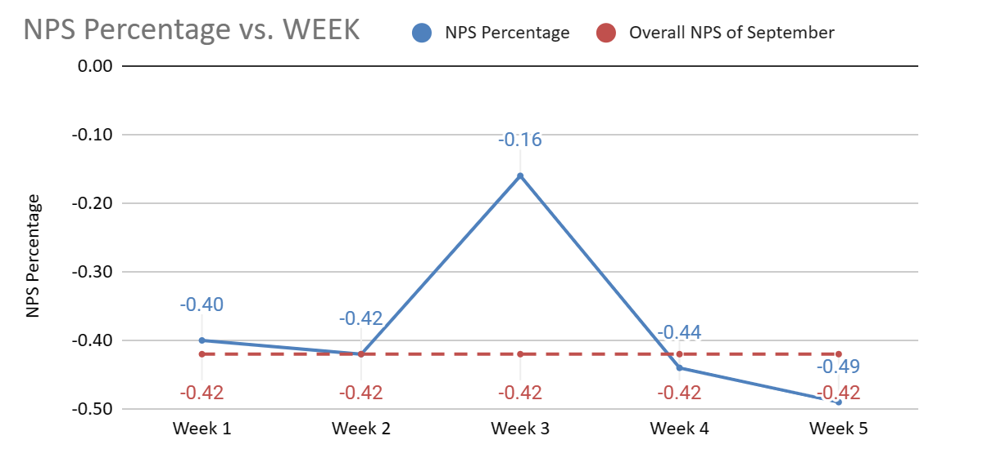
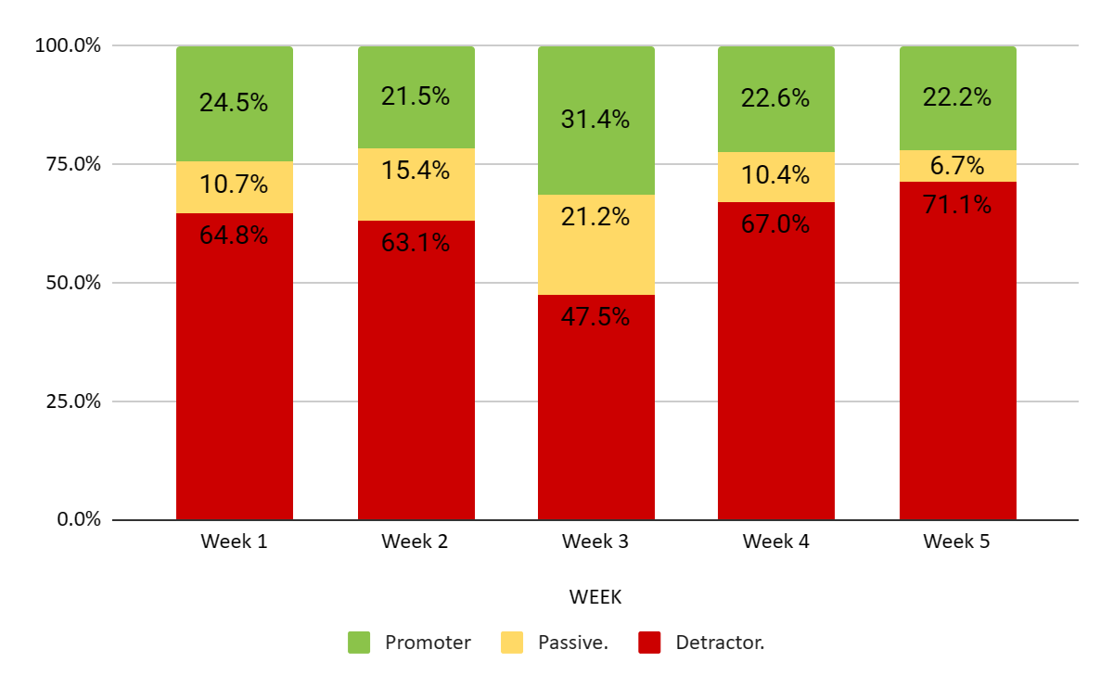
WEEK | Detractor | Passive | Promoter | NPS | Total | Detractor. | Passive. | Promoter | NPS Percentage | Overall NPS of September
Week 1 | 103 | 17 | 39 | -40% | 159 | 64.8% | 10.7% | 24.5% | -0.40 | -0.42
Week 2 | 123 | 30 | 42 | -42% | 195 | 63.1% | 15.4% | 21.5% | -0.42 | -0.42
Week 3 | 56 | 25 | 37 | -16% | 118 | 47.5% | 21.2% | 31.4% | -0.16 | -0.42
Week 4 | 199 | 31 | 67 | -44% | 297 | 67.0% | 10.4% | 22.6% | -0.44 | -0.42
Week 5 | 224 | 21 | 70 | -49% | 315 | 71.1% | 6.7% | 22.2% | -0.49 | -0.42
Grand Total | 705 | 124 | 255 | -42% | 1084 | 65.0% | 11.4% | 23.5% | -0.42 | -0.42
NPS & percentage change of Detractors, Passive, Promoters in the following weeks.
Week 2 NPS downfall reason is the decrease of promoters and increase of passive in an unfavourable rate.
Week 3 Increase being caused by increase in promoters & passive that decreased Detractors.
Week 4 Detractors increased rapidly decreasing passive by 10.8 % & decrease in promoters by 8.4%.
Week 5 passive again decreased resulting in increase in detractors affecting NPS.
Promoters remained in range of 21-25% in week 1,2,4,5.
Decrease in passive of week 5 showing that more customers are really upset and giving more detractors.

Slide 7
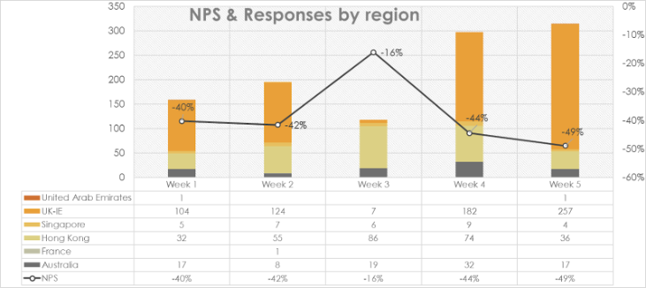
NPS & Responses by Region
Row Labels | Australia | France | Hong Kong | Singapore | UK-IE | United Arab Emirates | NPS
Week 1 | 17 |  | 32 | 5 | 104 | 1 | -40%
Week 2 | 8 | 1 | 55 | 7 | 124 |  | -42%
Week 3 | 19 |  | 86 | 6 | 7 |  | -16%
Week 4 | 32 |  | 74 | 9 | 182 |  | -44%
Week 5 | 17 |  | 36 | 4 | 257 | 1 | -49%
Total | 93 | 1 | 283 | 31 | 674 | 2
It has been observed that the upward and downward change in NPS has been majorly brought up by the change in responses of UK-IE clients.
As the decrease of UK-IE responses in 3rd week promoted the NPS to -16%. While increase of UK-IE responses depleted the NPS to -44% & -49% in 4th and 5th week.
Hence giving the insight to work majorly towards satisfaction of UK-IE clients.

Slide 8
As it can be seen from the following graph and table the NPS for each region. UK-IE responses being the highest followed by Hong Kong, Australia, Singapore, UAE and then France. 1st week was fine for Hong Kong & Singapore but not so good for UK-IE, Australia, UAE. 2nd week all the NPS declined slightly but Australia NPS got better and 1 response for France was recorded with detractor. 3rd week was the best for Singapore as its NPS got in positive 50% and was good for UK-IE as well as NPS got uplifted again to -43% but slight decline for Hong Kong to -13%. 4th week came out best for Hong Kong with 0% NPS but worst for UK-IE and Singapore, Australia. 5th week has been majorly declining as Hong Kong got declined to -31% but somewhat better for rest regions.1 detractor recorded from UAE.
The insight of increase of NPS of UK, Australia, Singapore in Week 3 gives understanding of upward movement of NPS.

Slide 9
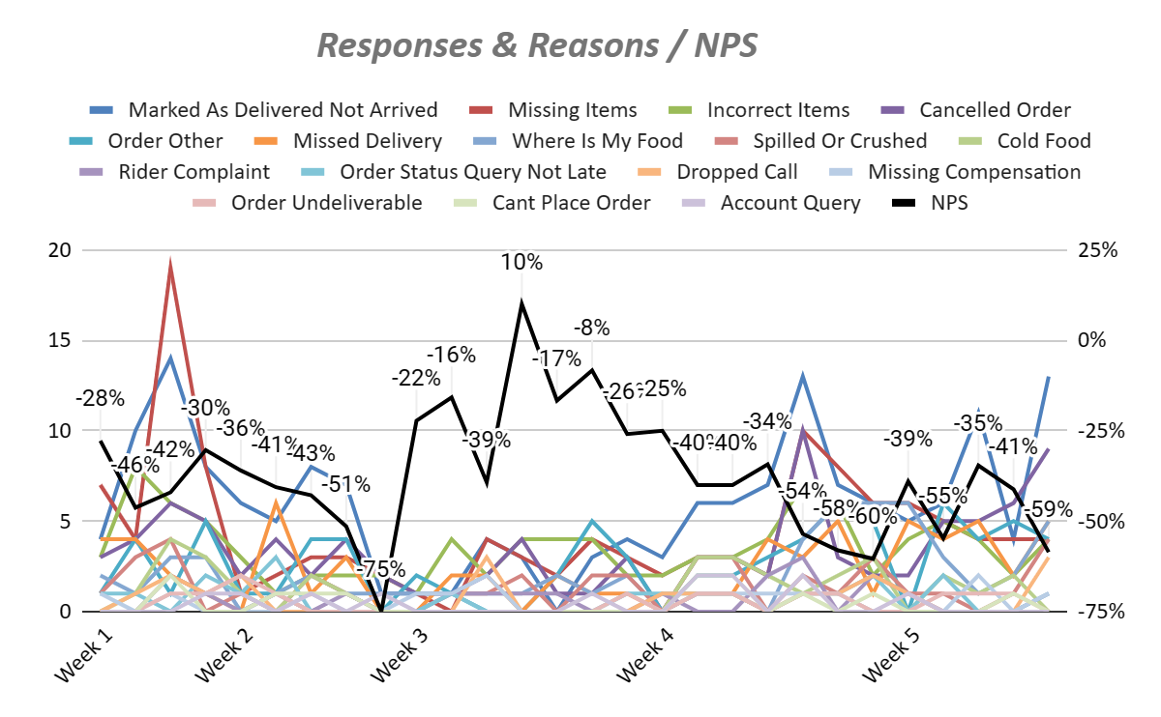
Responses & Reasons / NPS
Row Labels | Cancelled Order | Cold Food | Cooked Incorrectly | Dropped Call | Incorrect Items | Marked As Delivered Not Arrived | Missed Delivery | Missing Compensation | Missing Items | Order Other | Order Status Query Not Late | Order Was Late | Other | Promo Code Query | Rider Complaint | Spilled Or Crushed | Where Is My Food | Grand Total | NPS
Week 1 | 13 | 5 | 3 | 3 | 17 | 28 | 10 | 2 | 30 | 6 | 2 | 2 | 1 | 1 | 2 | 8 | 6 | 139 | -40%
Week 2 | 19 | 7 | 4 | 3 | 15 | 35 | 11 | 1 | 19 | 15 | 6 | 2 | 2 | 7 | 3 | 4 | 8 | 161 | -42%
Week 3 | 10 |  | 3 | 3 | 19 | 12 | 7 | 4 | 14 | 10 | 1 | 3 | 3 | 2 | 4 | 6 | 7 | 108 | -16%
Week 4 | 25 | 8 | 2 | 4 | 27 | 52 | 15 | 6 | 33 | 19 | 6 | 6 | 7 | 7 | 8 | 8 | 14 | 247 | -44%
Week 5 | 29 | 8 | 10 | 6 | 21 | 45 | 22 | 3 | 29 | 24 | 5 | 3 | 6 | 9 | 4 | 10 | 23 | 257 | -49%
Grand Total | 96 | 28 | 22 | 19 | 99 | 172 | 65 | 16 | 125 | 74 | 20 | 16 | 19 | 26 | 21 | 36 | 58 | 912
It can be seen that there is no major relation between any certain reason that is contributing to NPS fluctuations.
In following chart & table reasons with more then 10 responses have been chosen for relevancy.
Hence any specific reasons are not cause behind low NPS.

Slide 10
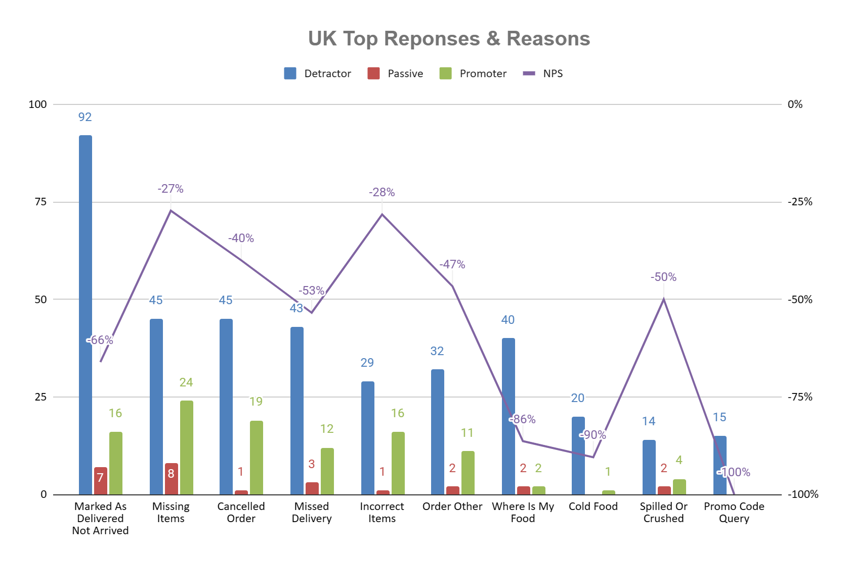
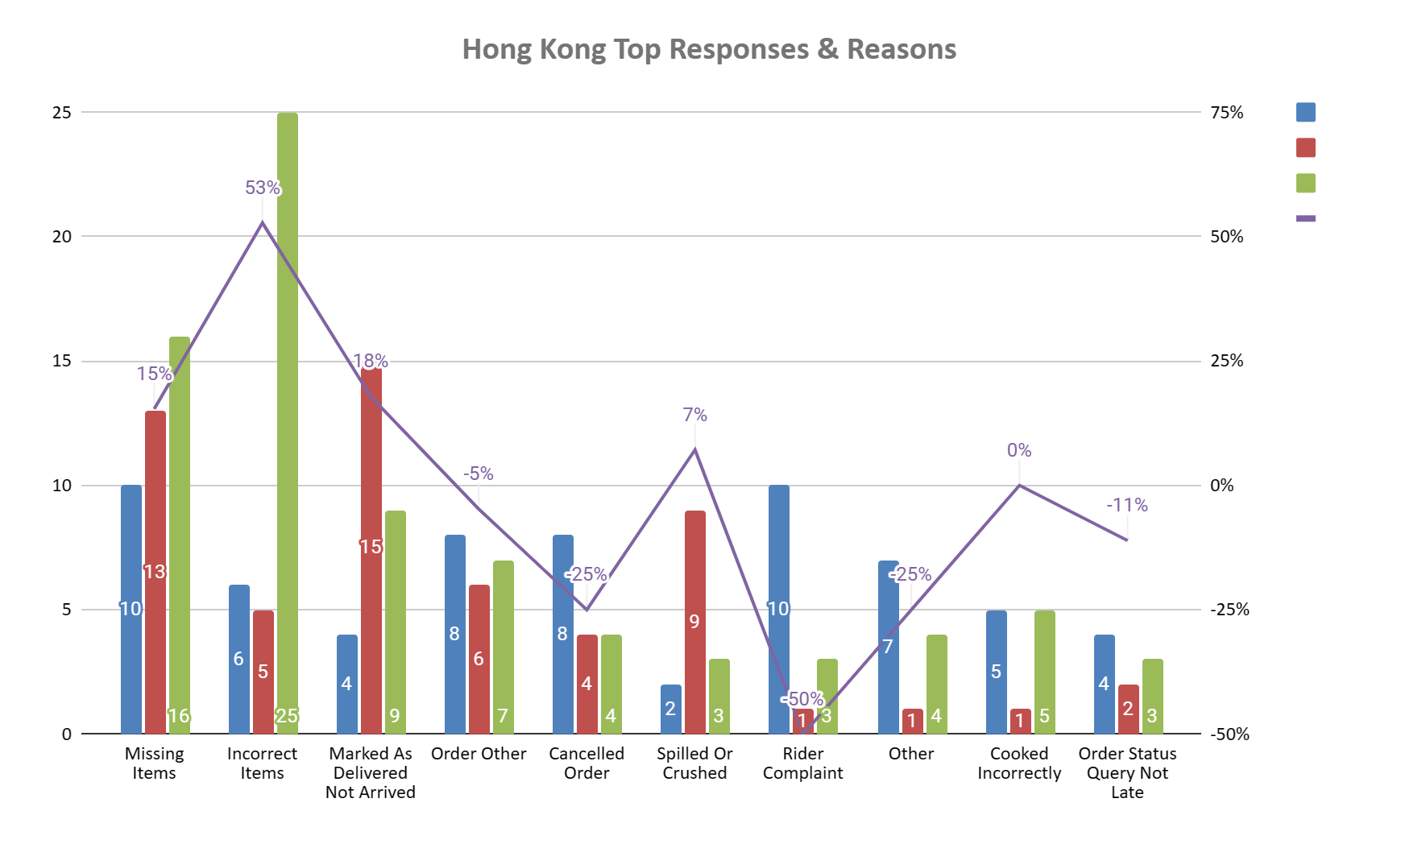
UK has been major contributor of calls & detractors hence paying attention to its top responses & reasons for it needs to be focused.
75% of total calls being covered by top 10 reasons in the chart.
Reasons with high responses and low NPS should be prioritised.
Where is my Food, Cold Food, Promo Code Query are among worst in NPS showing to work upon those reasons, that to be taken care of by client & by us.
Hong Kong has been a major contributor of calls & promoters hence maintaining and improving quality service is required.
70% of total calls being covered by top 10 reasons in the chart.
Reasons with high responses and low NPS should be prioritised.
Rider Complaint, Cancelled order & Other reasons seems to be top troubling thing for the customers.

Slide 11
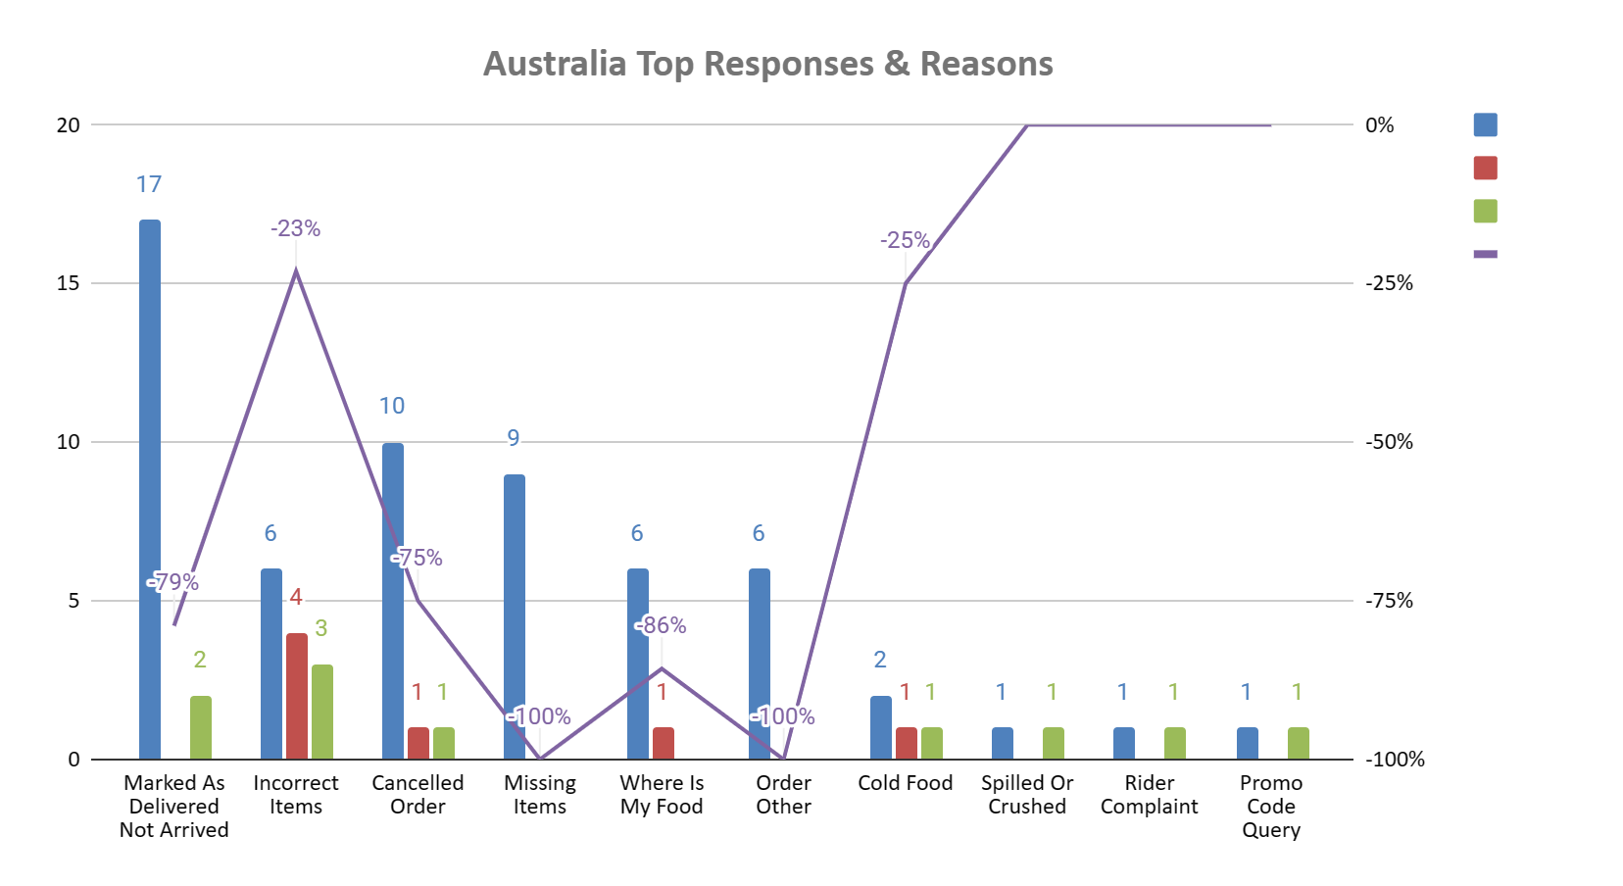
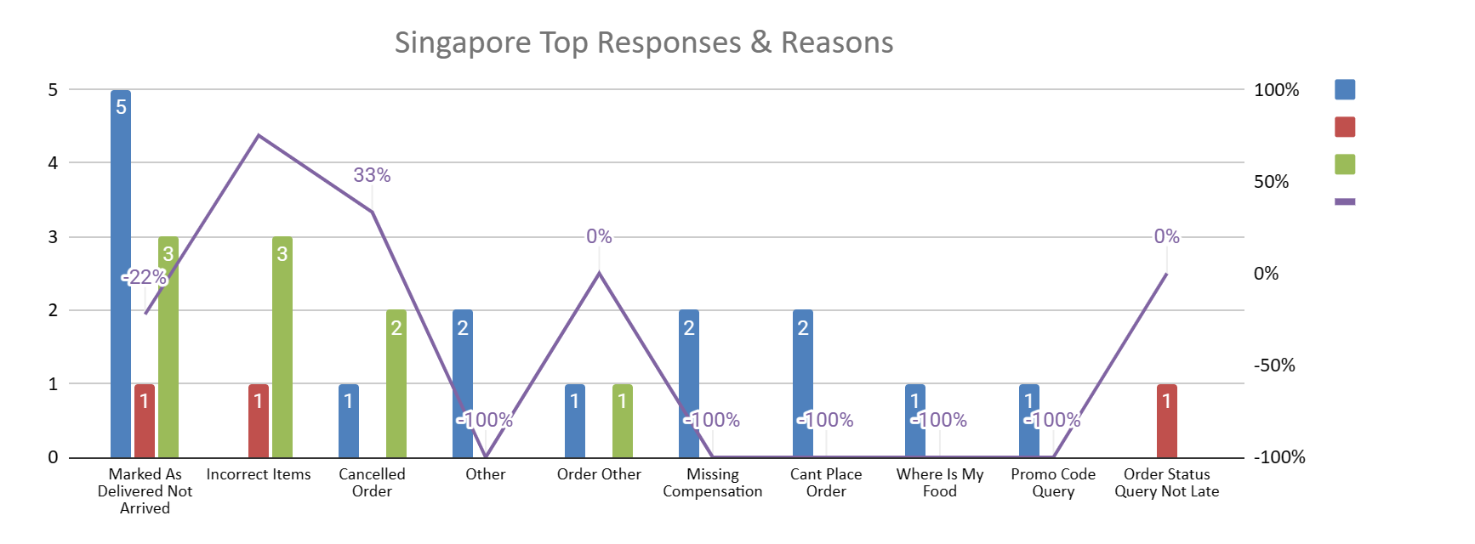
Australia is having continuous bad NPS throughout the weeks which is not good for the business, hence looking into the reasons and acting pro actively is must.
79% of total calls being covered by top 10 reasons in the chart.
Reasons with high responses and low NPS should be prioritised.
Only incorrect items & Cold Food are the reasons that can be manageable, rest reasons are not acceptable by Australian customers.
Singapore has rapid fluctuating NPS because of low calls but have been negative for Week 1,2,4,5 & positive for Week 3 hence more drill down is required.
83% of total calls being covered by top 10 reasons in the chart.
Reasons with high responses and low NPS should be prioritised.
France & UAE are not being considered because of single digit call numbers.

Slide 12
Thank You

